Slide 1
Introduction
Lead poisoning causes slow and subtle changes in the body. The physical manifestations of these changes occur at different stages of poisoning. A lot of people who are effect do not necessarily show symptoms of the poisoning and go untreated. There are several signs to look for in children and adults. While most of the time lead poisoning has been accidental, there have been times when lead was intentionally used to poison a person. This poster will look at the symptoms of poisoning, focusing mainly on the outwardly noticeable, and the few cases of Lead being used as an actual poison.

Slide 2
Symptoms in Children
Irritability/Aggression
Difficulty concentrating
Headaches
Loss of appetite
Weight Loss
Sluggishness
Fatigue
Abdominal Pain
Vomiting or Nausea

Slide 3
Symptoms in Children
Constipation
Pallor from anemia
Metallic taste in Mouth
Muscle and Joint Weakness or Pain
Seizures
Delay in Neurodevelopment
Growth Rate Reduction
Diarrhea or constipation
Osteoporosis

Slide 4
Symptoms in Adults
Low sperm count, sperm weakness, or sperm abnormalities
Impotence
Sterility or Infertility
Elevated Blood Pressure
Hypertension
Depression
Anxiety

Slide 5
Symptoms in Adults
Personality Changes
Suicide Attempts
Deficits in Short Term Memory
Insomnia
Aggression, Agitation, or Restlessness
Weight Loss
Cramps, Diarrhea, or Anorexia
Headaches
Teeth with blue/black lines near gum bases

Slide 6
Degree of Affects
Each individual is affected by lead in a different manner
People have been tested and had lead levels of 150 µg/100 ml and have no symptoms of lead poisoning
Some people can have half of this in their body and have full fledge signs of lead poisoning; hallucinations and all
Anything over 80 µg/100 ml needs to be treated as a full fledge poisoning
Lead attacks three bodily functions: formation of blood, workings of the nervous system, and the kidneys
  All of the symptoms presented in adults and children stem from these three system failures

Slide 7
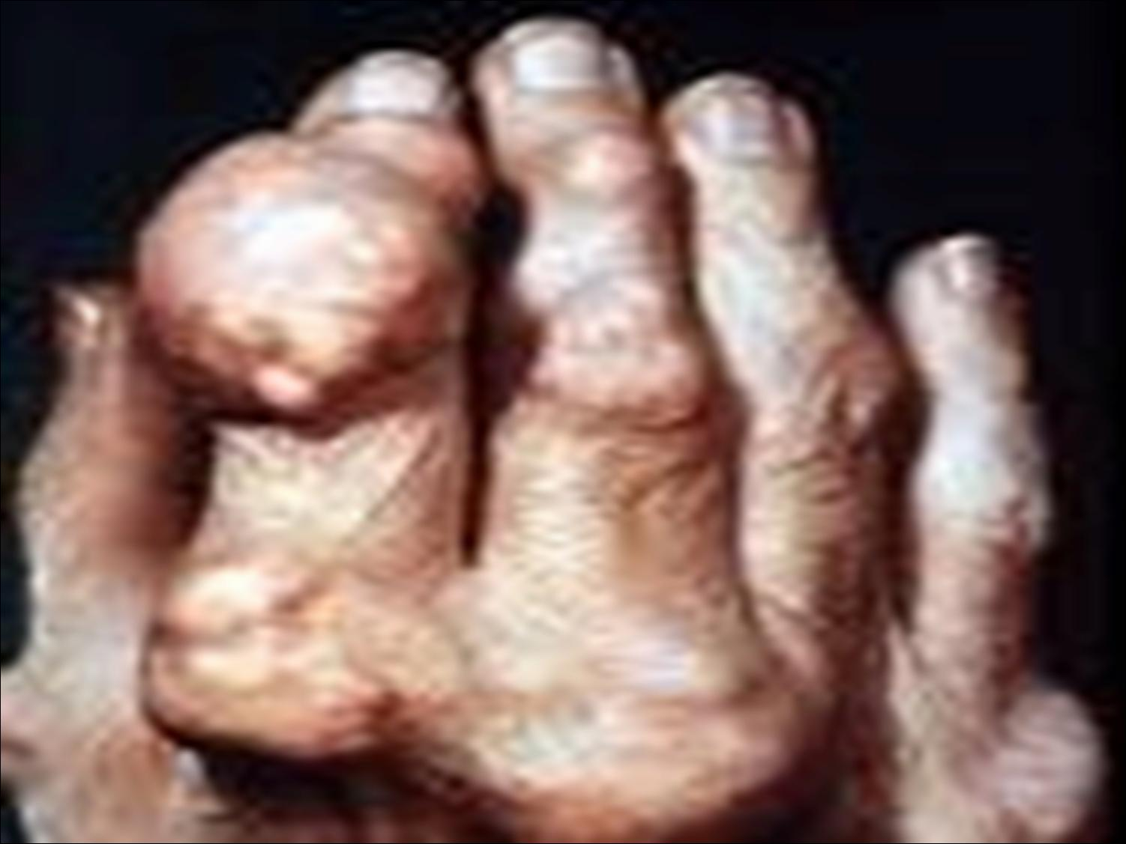
Gout
Gout was generally caused by an over indulgence in rich foods. There are still cases of Gout today, but for a while there was a strong connection between lead and Gout.
The port wines drunk caused a lot of gout. This was due to the wines either being tainted with lead or being kept in lead crystal decanters
Saturnine Gout: two large cases: one in the 1800s with port and one with Moonshine in 1900s USA

Slide 8
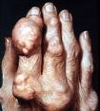
Gout
“Whether lead in drink really did cause gout is still debated because there seems to be no reason why this metal should suddenly cause crystals of uric acid to form between the joints, but it does (Emsley p.285).”
“Lead appears to interfere with the ability of the kidneys to excrete uric acid so the blood level increase until it reaches a critical level when it suddenly crystallizes (Emsley p.285)”

Slide 9
Gout
Men are more prone to gout; they have higher levels of uric acid in their blood.
Some men in history who have been known to have gout:
  Benjamin Franklin
  British Prime Minister William Pitt
  Poet Alfred Lord Tennyson
  Charles Darwin
  John Wesley (founder of Methodism)
Hypothesized that these men had gout also:
  Alexander the Great
  Kubla Khan
  Christopher Columbus
  Martin Luther
  John Milton
  Isaac Newton
  More than a third of all these men had elevated levels of lead in their blood and all enjoyed port wine

Slide 10
Devon Colic a case of accidental lead poisoning
The break out occurred during the 1700s across the English country
It affected mostly men and the symptoms included paralysis, madness, blindness, and death
In 1767 George Baker, the Queen’s physician, successfully proved that the Devon colic was caused by lead poisoning
He showed chemically that the Devon Cider often contained lead, where other ciders did not
The lead enter the cider through the lead-lined machines used to make the cider

Slide 11
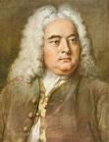
George Frederick Handel
1685-1759
Born in Germany, he was appointed musician to the Court of the Elector of Hanover, who became King George I of England
Handel went with the King and lived in London
His most popular work is the Messiah
He suffered from gout, due to his penchant for port
Drink was cause of gout which would have had lead in it
He suffered no other adverse affects of lead

Slide 12

Ludwig van Beethoven
1770-1827
Terrible colic that afflicted him all his life was due to lead
In 1802 the symptoms of chronic lead poisoning started to affect his hearing and he eventually became deaf
He was heavily exposed to the metal at the end of his life, which would have increased his symptoms
It has been scientifically proven that Beethoven was poisoned. Following with tradition after his death; Ferdinand Hiller was allowed to take a locket of Beethoven’s hair. This hair was passed through different members of the family, survived much transportation, and was auctioned in 1994, bought by the American Beethoven Society; six of the strands were tested in 2000
Beethoven’s hair had 60 ppm of lead which is a hundred times more than normal
This ended the assumption that he had mercury poison which would have been prescribed as a cure for syphilis
The locket would only have shown the last few months of his life; but there is no reason to think his eating and drinking habits changed
Also would not have been affected by dye as the colors of his hairs were grey, white and brown: indicating that he did not try to cover his graying hair

Slide 13

King George III
He had mild illnesses in 1762, 1790, and 1795
He also had illnesses in 1788, 1801, 1804, and 1804 which were all accompanied by alarming mental disturbance
In 1788 there was the Regency Crisis; the event was documented in extreme detail
“Chief features were severe constipation, colic, weakness in limbs, difficulty in swallowing, sleeplessness, with progressive mental disturbances that started with talkativeness and advanced irritability to delirium and coma”
George Baker was called in to help the King, but he was unable to diagnose that it was lead affecting the King
In July King George III went to Cheltenham to take the waters, he came back in August but relapsed with colic in October
Soon after his second relapse he suffered stomach pains, arm and leg cramps, constipation, and insomnia
His mind started to slip at the end of October, he became talkative and agitated. At times he would ramble or become giddy

Slide 14
King George III
On the fifth of November in 1788, King George had a fight with the Prince of Wales over diner. The topic of murder came up and the argument turned into a physical attack on his son
He was deemed cured at the end of February or beginning of March
For the rest of his life, King George continued to suffer bouts of colic, constipation, hoarseness, muscular pains, sleeplessness and delirium. He was also documented to have occasionally red colored urine
In 1812, his last attack, he was left blind and permanently mentally disabled
The cause of his illness was linked to porphyria. This is genetic and has been linked to some of his ancestors. People who are predisposed to porphyria are also more susceptible to lead poisoning and have more adverse affects at lower levels.
King George’s hair tested at 6.5 pp, which is more than ten times the normal level

Slide 15
1849 Mass Lead Poisoning
A 30 lb bag of lead acetate was accidentally mixed with 80 sacks of flower and used to make bread
500 people were affected, some showing the same symptoms that had afflicted King George III
Instead of being ashen some victims were ruddy looking, some had red colored urine
Another feature of poisoning is recurrence of the symptoms several weeks after eating the contaminated bread

Slide 16
Thomas Taylor
He lived with his wife Ann, his son (whom was born of another woman), and his brother Charles (who was recently released from prison)
Soon arguments started when Thomas began to accuse Ann of being over affection to Charles, Ann said she preferred Charles to Thomas and wished he were dead
In August Thomas was over come with violent pains in his stomach, lasted several days, he went to a doctor who gave him opium pills to kill the pain and senna water to act as a laxative
The treatment failed to work and the doctor prescribed larger does
The doctor noticed that when Ann went to collect more senna water she had the original bottle with her and the dregs were now a different color and tasted odd
Thomas died on September 4th; the doctor would not issue a certificate of death until he was able to do a post-mortem
Samples from the stomach and liver showed that there were high amounts of lead carbonate; Thomas was poisoned by white lead
Ann and Charles were accused of willful murder, she awaited trial and he disappeared

Slide 17
Honora Turner
She married a man named James; the marriage was going poorly so he left her. Honora complained to his employer that he had abandoned her
James wanted to be entirely free of her so he convinced a co-worker to by some lead acetate
The men went to her home, with his co-worker distracted his wife, Turner put lead acetate into the beer that his wife and her friend were drinking
The two women became ill and Honora complained to the police, charging her husband with attempted murder
When the police went to her house they found lead acetate under the floor boards where Honora had been sitting
Both men were arrested and faced trial

Slide 18
Louisa Jan Taylor
Although little is known about her early life, it seems that she married a man who could have been her father, it was done in secret and when he died his relatives were surprised to see he was married
Through the course of her life, she had an affair with and Edward Martin (who was married)
She was not good at managing money and soon after her husband’s death found herself far in debt.
In an act of desperation she went to the Tregillis, old friends of her late husbands, lied to them claiming she had inherited 500 pounds, and asked if they wanted her old furniture as she would be buying new things. She also asked if she could move in for a few days while she waited for her things to get in order
About weeks after she moved in, the two women went for a walk and were mugged. Mrs. Tregillis cut her face and a doctor was called, Louisa asked the Doctor’s wife (who ran the pharmacy) about lead acetate for herself, implying that she needed it to douche herself
She bought lead acetate, and it appears she began to slip it into Mrs. Tregillis’s medicine
After a month or so of poisoning the lady, and stealing from the couple, people were finally suspicious of what was happening and called the doctor and police in

Slide 19
Louisa Jan Taylor
Tregillis had a blue line running across her gum which indicated lead poisoning
Louisa was arrested and sentenced to trial
At the first trial, Mrs. Tregillis was able to testify and stated that she saw Louisa slipping white powder into her medicine
The medicine tasted bitter, because the combination of chemicals, so the added lead acetate did not go unnoticed or sweeten the medicine.
At the second trial, after Mrs. Tregillis had passed, evidence from the autopsy indicated lead poisoning, but did not point to it as the cause of death.
She most likely suffered from a heart attack a few days before her death, the lead in her body just accelerated this and did not allow her retain her health, she also was over 80 years old when all of this occurred
Louisa was charged with the murder of Mrs. Tregillis, she was also suspected of the poisoning of her husband and two other women. Louisa eventually was hung for her crime

Slide 20

Pope Clement II
In 1959 samples of Pope Clement II bones were tested and it was confirmed that there was a level of lead far larger than normal
His death in 1047 had long been a mystery, and the lead indicates that there was someone poisoning the Pope
The time when Pope Clement II was in the papacy was a very controversial period. At one point there were three men all claiming the title of Pope.
Clement II was only in office nine months and not very popular among the people.
It is uncertain if Benedict (one of the three) had him poisoned or if Clement poisoned himself.
Clement was fond of the German wines which were adulterated with lead acetate. If he drank the wine daily then his lead level would already have been elevated, and if someone else had been adding more lead to the wine or some other source, then that would have accelerated the death of the pope.

