Slide 1
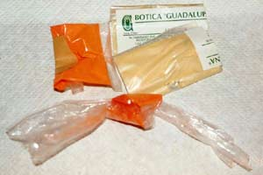
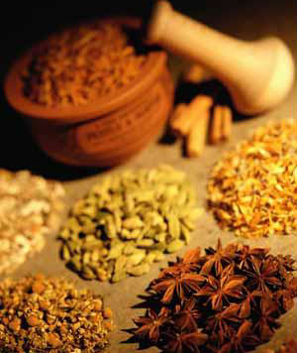
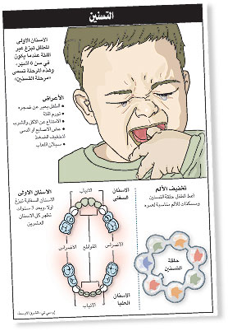
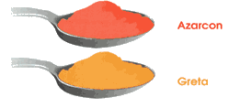
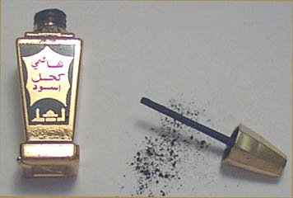
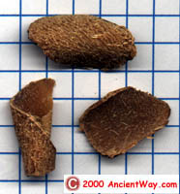
Lead in Folk Medicines: A Cure Worse than the Ailment
Richard Linchangco
Introduction and brief Overview
In trying to combat lead poisoning, public-health policymakers have focused on environmental sources of the toxic metal -- such as paint, gasoline, drinking water, and soil. However a large, but largely unknown source of lead poisoning has been largely ignored. It is a major source of poisoning that is hidden behind a cultural curtain. That source is folk medicine.
Folk medicines come from a tradition of medical knowledge developed over centuries within various cultures before the birth of modern medicine. These medicines are so engrained within the cultures and so common that for many people in the world, it is the primary source of health care even after the introduction of modern medicines. For example, in India, 80% of the population uses folk medicines. These include, but are not limited to: Ayurvedic medicine from India, traditional Chinese medicine, and the traditional medicines of South America.
Data and studies from other countries besides the US regarding lead poisoning from folk medicines are hard to find. Therefore, this project will focus mostly on folk medicine-caused lead poisoning in the United States.
Which folk medicines contain lead?
Lead can be found in the folk and herbal remedies of South American, Middle Eastern, Ayurvedic, and Chinese traditional medicine..
Below is a table of common folk medicines which contain lead, a basic description, the origin of the medicine, and the ailments they are supposed to treat.
Folk Medicine | Description | Origin | Ailment treated/Effect
Azarcon (also known as alarcon, luiga, maria luisa, or rueda) | Bright orange powder made of lead tetraoxide | Central and South America | Empacho (loss of appetite and constipation)
Greta | Yellow powder used in glazing pottery | Central and South America | Empacho
Ba-Baw-Sen | Herbal medicine | China | Hyperactivity in children, colic pain
Bint Al Zahab | Ground up rock mixed with honey and butter | Iran | To encourage the first stool of a newborn
Bint Dahab | Yellow lead oxide commonly used by jewelers | Saudi Arabia | Constipation
Bokhoor | Wood and lead sulfide burned to create fumes | Kuwait | To calm infants
Jin Bu Huan | Herbal medicine | China | Pain relief
Pay-loo-ah | Red powder | Vietnam | Fever or rashes in children
Kohl (also known as Surma) | Black powder | India | Put on gums of teething babies to sooth pain
Ghasard | Brown powder | India | Digestion problems
Santrinj | Red powder, 98% lead oxide | Saudi Arabia | Gum infections and teething pain
Why is there lead in folk medicines?
Folk medicines have a history in their respective cultures going back thousands of years. One main idea in the use of folk medicines is homeopathy. This is the age-old idea that when someone is suffering from an illness or bad condition, a way to cure the illness is to administer a medicine that produces similar symptoms to the illness. With lead-based folk medicines, many times they are treating symptoms that are present in higher levels of lead poisoning, a common symptom being colic and loss of appetite. This is one cultural basis as to why the medicines are being used.
Additionally, the application of lead to skin and mucus membranes have been known to have astringent properties that are useful in treating inflammation in quick doses, like that associated with teething in babies, and inducing diarrhea and vomiting.
There is another way lead gets into folk medicines. Sometimes lead is not the main “active ingredient” in the folk medicines. It can come into the medicines through contamination during the manufacturing process or be present in colorants used in the medicines.
However, despite the apparent curative properties of lead, the danger of lead poisoning outweighs any good that could come from using these folk medicines.
Lead Encephalopathy due to Folk Medicines: A Case Study
Karri et al. collected data of 76 individuals afflicted with lead encephalopathy due to folk medicines . This is a symptom of moderate to high lead poisoning where brain function is altered. They recorded the results of laboratory tests as well as the origin of the folk medicines taken.
Ayurvedic medicines were associated with 5 cases (7%), Middle eastern traditional medicines with 66 cases (87%) and 5 cases (7%) with other traditional medicines. Of the 76 cases, 5% were in adults and 95% were in infants and young children. Of the 4 adult cases, at least one was left with residual neurological impairment. In infants and young children, among 72 cases 8 (11%) were fatal, and at least 15 (21%) had residual neurological deficits.
Lead poisoning due to folk medicines is a big problem, and many times, it is not caught until it is too late and damage is irreversible.
Traditional Medical System | Cases of Lead Encephalopathy N (%)
Ayurveda | 5 (7%)
Ghasard | 1 (1 %)
Traditional Middle Eastern Practices | 66 (87%)
Azarcon and Greta | 2 (3%)
Traditional Chinese Medicine | 2 (3%)
Total | 76 (100%)
Case Report of a Woman from New Zealand
Patient: 51 year old New Zealand woman who recently returned from three year stay in India.
Presenting symptoms: Nausea, vomiting, abdominal pain and myalgia.
Past medical history: She had dengue fever and was taking Ayurvedic medicines for 10 months.
Clinical signs and symptoms: The patient was anemic and showed memory loss, disorientation, loss of sensory perception and tender abdomen.
Blood lead level: 69.3 μg/dL
Blood film: Normochromic anemia with prominent basophilic stippling.
Diagnosis: Chronic Lead encephalopathy.
Therapy: Discontinuation of Ayurvedic medicine.
Outcome: Patient clinically well and blood lead levels dropped to 20 μg/dL after 5 months.
Most Common Reasons Cited by Patients for Not Revealing Their Folk Medicine Use to Medical Practitioners
Their doctor never asked them about it.
It wasn't important for their doctor to know.
It was none of their doctor's business.
Their doctor would not understand.
Their doctor would disapprove.
Their doctor would discourage them.
Their doctor might not continue as their provider.
Azarcon and Greta, two folk medicines used by people of Central America and South America
Both are used for constipation and stomachache in children and contain up to 90% lead by weight.
Why are these folk medicines so dangerous?
Folk medicines are manufactured outside of the US and most of the time, they brought in suitcases by travelers, allowing them to bypass regulations. No one is testing these medicines to see if they are dangerous or not. They are typically sold in ethnic grocery stores, making them easily and readily available to those wishing to buy some. Additionally, the people using the medications more often than not do not know what is in the medications, and some of these medicines contain up to 90% lead by weight. Many of these folk remedies are made to be used on children, who are more susceptible to lead poisoning. It is estimated that up to 30% of childhood lead poisoning in the United States is due to folk medicines.
Additionally, pharmacists and health care providers are generally uninformed of the risks caused by these medicines, and do not tend to ask patients about them until it is too late.
Jin Bu Huan
a traditional Chinese medicine
Above image: public service poster in Arabic warning not to use lead-based teething powders
Right: Traditional medicines about to be prepared
Kohl, also known as surma
What can be done to prevent lead poisoning from folk medicines?
Several things can be done to prevent lead poisoning from these medicines. One possibility is tighter monitoring of the medicines and herbal supplements and more testing of them done by the FDA. However, this has limited efficacy due to the fact that most of the medicines are “smuggled” into the US. Additionally, the issue is not well-known publically. Most of the concern for lead poisoning comes out of lead paint, lead in toys, and lead in the soil. Therefore, publicizing the dangers of the folk medicines is a relatively cheap, effective way of preventing cases of lead poisoning from these medicines. Public health officials, especially in the more affected areas like the Southwest, should run a public service announcement campaign.
Still, the medicines will be available. Because of the traditional, cultural basis of these medicines, they cannot be completely eliminated. However, preventing more cases by monitoring and increasing public knowledge is a definite possibility.

