Slide 1

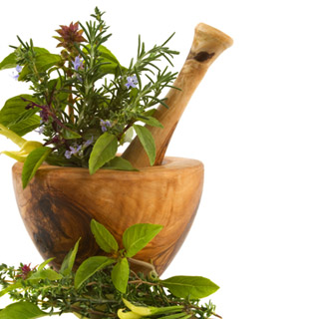
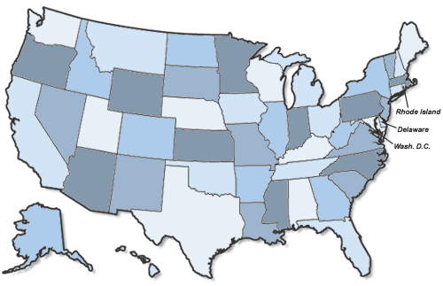
Remediating The Remedy:
Dangers of Lead in Traditional Medicine
Paylooah (Southeast Asia)
CASE: May 3, 1983; St. Paul, Minnesota
  A 6-month-old Hmong girl from northern Laos was found to have a blood lead level of 60 ug/dl. She presented with no signs of lead poisoning and all of her physical examinations were asymptomatic. Physicians were only made aware of the lead poisoning by blood testing and X-ray films. After detailed questioning ,it was revealed that her parents had given the baby paylooah as a cure for a previous high fever.⁶
What Clinicians and Patients NEED to Know:
Paylooah: a red powder used in Southeast Asia to cure fevers and rashes in infants. It has a lead concentration of 8% by mass. ⁶
Officials in Minnesota obtained other folk remedies containing as much as 90% lead. Also, Arsenic was also found at concentrations of about 70-80%.⁶
HAZARDS: For an infant, a blood lead level at 60 ug/dl will potentially cause severe cases of colic, anemia, developmental toxicity and decreased IQ, Hearing, Physical growth.¹²
Koo Sar (Chinese/Eastern Asia)
CASE: February 19, 1997 (Connecticut)
  A 33 year-old Cambodian woman was given a free lead-screening sponsored by a local community health promoter. Although she reported no symptoms of lead poisoning such as muscle pain, weakness, or headaches, her lead blood level was 44 ug/dL. For 3-4 years, she had taken 6 Koo Sar Pills for seven days each month to help releave menstural cramping.⁹
What Clinicians and Patients NEED to know:
Koo Sar Pills: Red pills generally used in China for menstrual cramping and excessive bleeding. Lead is not listed as an ingredient, but it used in the red pill colorant.⁹
Other dangerous Chinese folk medicines are Ba-Baw San (which is commonly used for colic and pacifying young children) and Po Ying Tan ( which contains 7.5 mg of lead per dose, and is used for various aliments).²
HAZARDS: For an adult , a blood lead level of 44 ug/dL will potentially cause Hypertension, anemia, hearing loss, kidney damage,infertility in men, and nerve problems.¹²
Abstract:
The use of traditional medicine, while generally common abroad, is becoming increasingly popular in the globalized society of the U.S. This project works to provide important and necessary awareness concerning the dangers of lead toxicity associated with many ethnic remedies. Unfortunately, many cases involving lead-containing folk medicines go unobserved and untreated due to ambiguous symptoms and unaware healthcare personnel. The purpose of this research, with detailed case studies, is to introduce healthcare providers and the public to the most common leaded folk medicines, as well as to provide an idea of the most at-risk locations in the U.S.
Ayurveda (Indian Subcontinent)
CASE: New Hampshire 2001
  37 year old female with rheumatoid arthritis presents in the ER with abdominal pain, nausea, and vomiting for a duration of 6 days. Bloods tests reveled severe microcytic anemia and a blood lead level 81 µg/dL. The patient had been taking five different ayurvedic traditional medicines for her arthritis symptoms.³
What Clinicians and Patients NEED to know:
  Ayurveda is a name for a wide ranging system traditional medicines from India. These medicines have a lead content from about 0.4-261,200ppm.³One of the most typical ayurvedic medicines is an fertility pill.¹⁰
Approximately 80% of India’s one billion population currently uses Ayurveda and this system is gaining popularity in Western countries such as the U.S. They are even attainable from health-food stores and on the internet.²
Ayurvedic medicines containing toxic metals such as lead as been document in Chicago, Houston, New York and Canada.²
HAZARDS: For an adult, a blood level of 81 µg/dL will potentially cause anemia, decreased life-span, nerve problems, infertility in men, increased blood pressure, and hearing loss. ¹²
Azarcon (Latin America)
CASE: May-June 1982, San Diego California
  15 month old baby and 3 year old sibling presented symptoms of chronic diarrhea and were treated with ampicillin. One month later both children were brought back with intense lead poisoning due to azarcon (lead oxide). Azarcon was supplemented by the family because ampicillin was not working.⁷
  Younger child was found to have blood lead level measurement of 124ug/d.⁷
  3 year old died with intense seizures due to azarcon-induced lead encephalopathy.⁷
What Clinicians and Patients NEED to Know:
  Azarcon is an orange powder that contains 86-95% lead tetroxide. It is often used by Mexican folk healers to treat “empacho” or abdominal problems such as diarrhea.⁵
  This medicine is very prominent in Mexican households. June 1982, the Los Angeles County Department of Health Services surveyed 545 Hispanic households to estimate exposure to and knowledge of azarcon and greta (another lead oxide powder similar to azarcon). 25% of those surveyed were familiar with at least one of the substances. 7.2-125% admitted to prior use within the past year. However, investigators noticed a great reluctance to admit to uses of greta and azarcon thus the incidence of ingestions may have been higher than survey results show.⁷
  Hazards: For a child (<18 yrs old), a blood lead level of 124ug/d will generally cause comas, seizures, kidney damage, frank anemia, colic, never damage, brain damage, severe physical developmental problems. An equivalent blood level in an infant would likely be fatal.¹²
What is Traditional Medicine?
According to the World Health Organization, “traditional medicine refers to health practices, approaches, knowledge and beliefs incorporating plant, animal and mineral based medicines, spiritual therapies, manual techniques and exercises, applied singularly or in combination to treat, diagnose and prevent illnesses or maintain well-being”¹.
These symbols designate states that I have found research reporting lead poisoning due to traditional medicine use. The normal blood level of an adult is <20µg/dl and for children <10 µg/dl.¹¹
A Call to Educate:
As seen from the above cases, there is a definite need for increased education about traditional medicines and their possible toxicity. Traditional medicine accounts for about 30 percent of all childhood lead poisoning cases in the U.S.⁸. Unfortunately, because only 14 percent of children are tested for lead nationwide, this number may be artificially low. According to the Journal of Current Drug Safety², the top two reasons that most toxic folk medicine cases go unreported are ignorance on the part of many clinicians about the use of traditional medicines, and the of patients’ lack of awareness about toxins in the medicines they are using. As seen from the paylooah case above, the signs and symptoms of lead encephalopathy are often non-specific and will go unnoticed if healthcare providers and the public are not made aware of its possibility. With the use of culturally appropriate educational efforts and greater communication between doctor and patient, many of the potential health risks posed by these lead-bearing remedies can be avoided or abolished.

