Slide 1
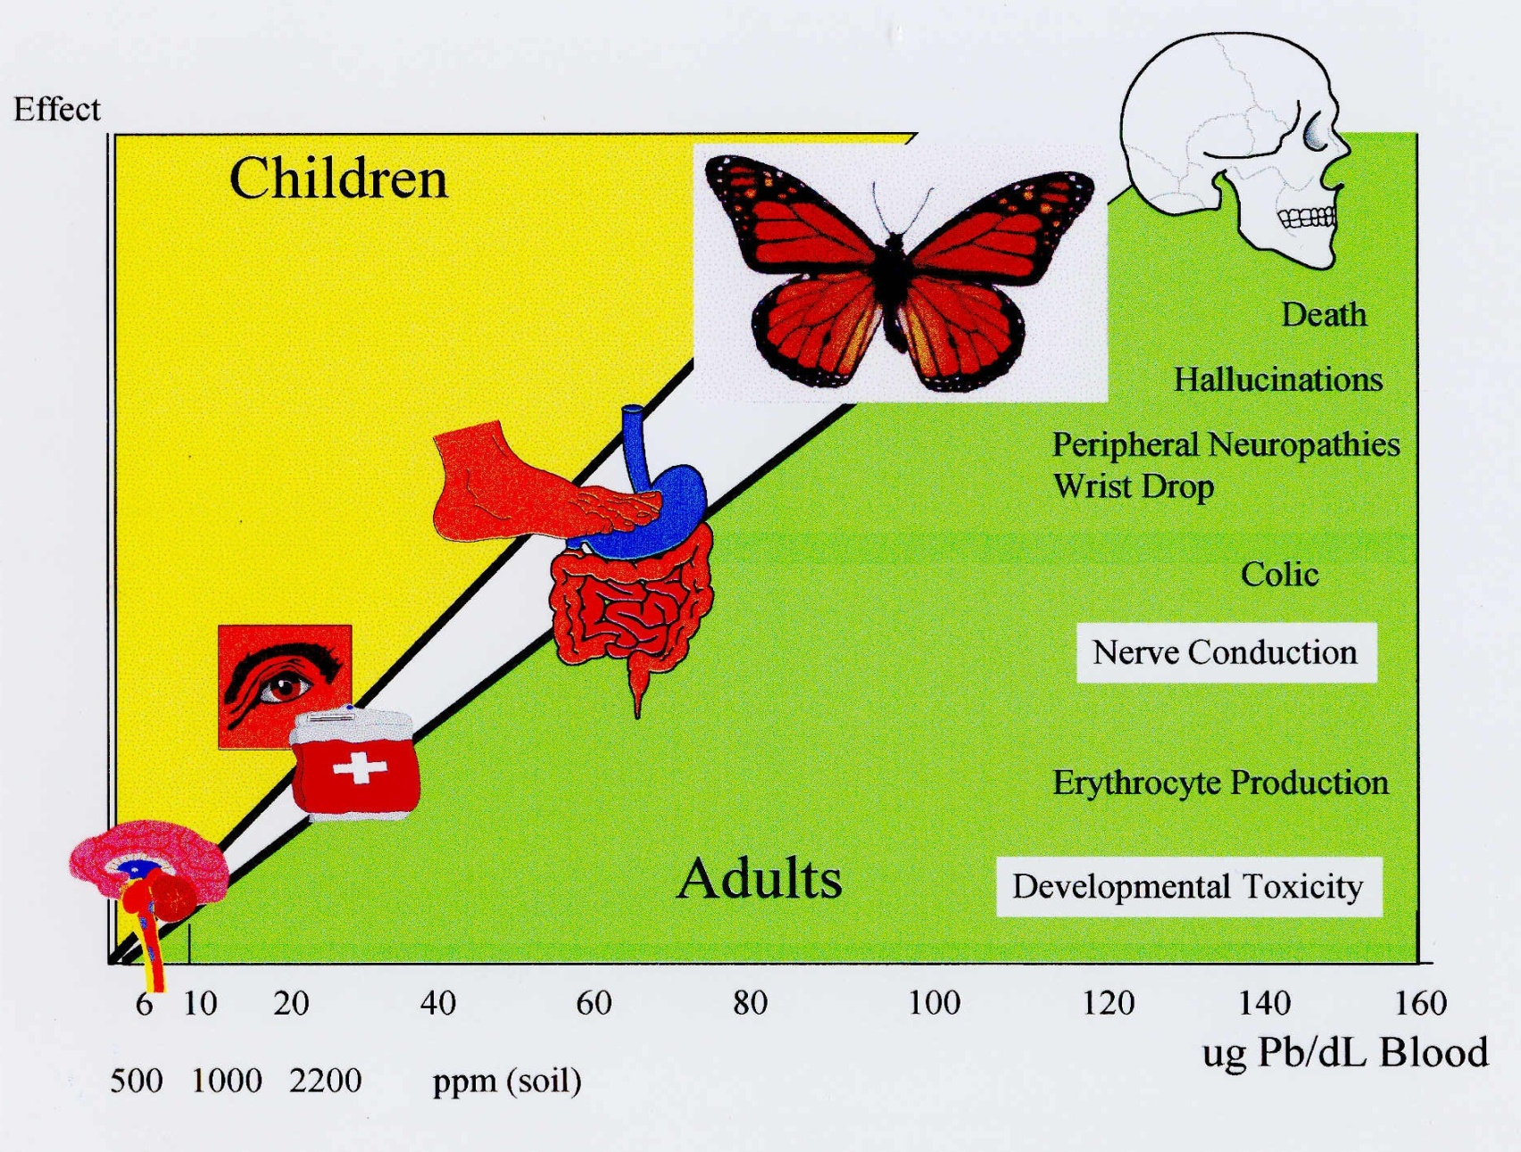
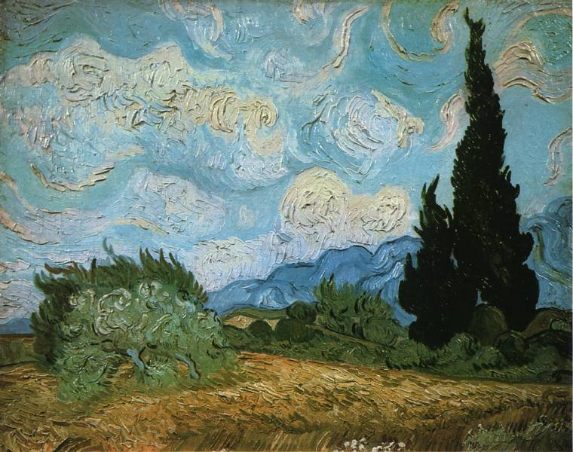
The Madness? Of Vincent Van Gogh
Kari Kronsbein
Loyola University Chicago
Abstract
Other Suggested Diagnoses
Documentation of Symptoms
The diagnosis for the mental disorder of Vincent Van Gogh has been disputed among scholars since his premature death in 1890. The final months of his life were marked with periods of erratic, violent behavior (or what Van Gogh called attacks), but upon reading his letters and studying the art that were produced during this period, it is clear that Van Gogh’s mind was largely lucid during the time between these attacks. The various symptoms which Van Gogh experienced, from extreme and frequent colic , to wrist drop, to convulsions and hallucinations, can be symptomatic of many diseases and disorders, but from studying Van Gogh’s descriptions of his own physical and mental state, I suggest that these symptoms are largely characteristic of lead poisoning, although his death was not a direct result of lead poisoning.
It has been widely suggested that Van Gogh was an epileptic, due to a family history of diagnosed epilepsy (a maternal aunt died of epilepsy), as well as the diagnosis of Dr. Peyron. This diagnosis does not account for all of the symptoms with which Van Gogh was plagued.
The idea of Van Gogh as a schizophrenic was suggested by Karl Jaspers in 1922, but has since been proven obsolete by scholars.
Syphilis is a popular diagnosis for Van Gogh’s mental state, but madness caused by syphilis does not generally occur in “episodes,” as was the case with Van Gogh.
Other diagnoses include Menière’s syndrome, absinthe intoxication, bipolar disorder, cycloid psychosis, sunstroke, and acute intermittent porphyria.
In his first major attack, Van Gogh reportedly threatened his roommate, Paul Gaugin, with a razor. In his delirium, he cut off his own ear and presented it to a prostitute in a brothel. Van Gogh had no recollection of his actions during his violent state.
Reportedly, his doctors diagnosed him as “really only anemic,” and told him “that I must feed myself up” (484). Anemia is often an early symptom of lead poisoning.
Van Gogh was often haunted by hallucinations: “The unbearable hallucinations have ceased, and have now reduced themselves to a simple nightmare” (487).
In February of 1887, Van Gogh was again hospitalized because he imagined that people wanted to poison him. While in the hospital, he describes the strange pattern of his illnesses: “I feel quite normal so often that I should think that if what I have is only a malady peculiar to this place, I must wait quietly till it is over, even if it returns again” (492).
In February of 1887, Van Gogh was again hospitalized because he imagined that people wanted to poison him. While in the hospital, he describes the strange pattern of his illnesses: “I feel quite normal so often that I should think that if what I have is only a malady peculiar to this place, I must wait quietly till it is over, even if it returns again” (492).
His fears about his illness at least show an awareness of his disease, something unusual for those who suffer from madness caused by syphilis or those plagued by schizophrenia: “These repeated and unexpected agitations, if they should continue, may change a passing and momentary mental disturbance into a chronic disease” (496).
Van Gogh describes his mood swings and his decline into depression: “There have been moods of indescribable mental anguish” (497). “I am well now, except for a certain undercurrent of vague sadness difficult to define” (499).
Van Gogh entered the asylum at Saint-Rémy, not because of his madness, but because his care would be easier in the facility. While in the asylum, Van Gogh was relieved that he was not the only one who suffered from hallucinations: “I gather from others that they have heard during their attacks strange sounds and voices, as I have, and that to their eyes too things seemed to be changing.” “There is someone here who has been shouting and talking as I do all the time” (511).
The intensity of Van Gogh’s episodes is described, and Rey’s diagnosis of epilepsy is noted: “The anguish and suffering are no joke once you are caught by an attack. Most epileptics bite their tongue and wound themselves. Rey told me that he had seen a case where someone had wounded himself as I did, in the ear” (512).
The increase in Van Gogh’s hygiene coincides with improved gastrointestinal function: “I am having a bath now twice a week, and stay in it two hours; my stomach is infinitely better than it was a year ago” (512).
Van Gogh’s anguish about his attacks are described: “I am unable to describe exactly what is the matter with me; now and then there are horrible fits of anxiety, apparently without cause, or otherwise a feeling of emptiness and fatigue in the head.” (Fell 155)
Exposure to Lead
The painting technique frequently utilized by Van Gogh is known as impasto. This technique involves an extremely heavy paint application in which the brush strokes or marks of the pallet knife are usually visible (see Figure 1). While this technique accounts for much of the expression in Van Gogh’s paintings and is one of the most famous attributes of his paintings, it also increased the amount of Van Gogh’s exposure to lead-based pigments.
Van Gogh frequently ‘tipped’ his brushes when painting. Due to his rapid painting technique, the pointed tip of Van Gogh’s brushes had to be reformed to regain precision. Disregarding the health risk, Van Gogh would tip his brushes using his mouth. It is unclear how much paint he would have ingested in his lifetime using this method.
To create a more vivid foreground, Van Gogh would prime his canvas with lead-based white pigments, and then sand his canvases to create a smooth surface once the paint dried. This creates the hazard of leaded dust, the most dangerous exposure.
Van Gogh was notorious for his lack of hygiene when it came to his painting. He would spend weeks without washing his skin, which was often covered with paint. Van Gogh was a heavy smoker, especially when painting. The paint on his hands could have been easily ingested while smoking.
Symptoms of Lead Poisoning Experienced by Van Gogh
Convulsions: Swelling within the brain leads to convulsions like the “attacks” from which Van Gogh suffered.
Pica: Van Gogh was twice caught ingesting his paints after an uncontrollable urge to consume them.
Difficulty balancing
Vision impairment: Lead poisoning causes the swelling of the retinas, which forces the appearance of rings around light sources, as often portrayed in Van Gogh’s paintings.
Wrist drop: Van Gogh stated: “the brush is almost falling
from my fingers” (649).
Acute colic
Gastrointestinal spasms
Hallucinatory behavior
Minor anemia
Mental disorders
Impasto Technique
Effects of Lead Poisoning
References
Erickson, K. P. (1998). At Eternity's Gate: The Spiritual Vision of Vincent Van Gogh. Grand Rapids: William B. Eerdmans Publishing Company.
Fell, D. (2004). Van Gogh's Women. New York: Carrol & Graff Publishers.
Fitch, A. (2004). Sublime Lead: The Biography of a 5000 Year Toxic Love Affair. Retrieved December 11, 2008, from http://www.luc.edu/faculty/afitch/Lead%20and%20Humanity.htm
Stone, I. (Ed.). (n.d.). Dear Theo: The Autobiography of Vincent Van Gogh. Garden City: Doubleday & Company, Inc.
Van Gogh, Vincent. Van Gogh's Letters. Ed. Robert Harrison. 2008. US Department of Education. 11 Dec. 2008 <http://www.webexhibits.org/vangogh/>.
Figure 1. Wheat Field with Cypresses. Van Gogh. 1899.
Figure 2. Power Point Presenation. Alanah Fitch.

